Slide 1
Web App
Group Assignment of BDAT1001-Group 9

Slide 2
Project Summary
Purpose: The purpose of this web app is to provide a secure login and registration process that is accessible only to authorized users, such as managers and admins.
Functionality: Includes a login and registration page, accessible only with authorized access.
Technology: Built using ASP.NET Core Web App, with the latest security features.
Benefits: Provides secure and efficient access to important information and tasks, reducing the risk of data breaches and unauthorized access.
Future Plans: Built on a scalable and flexible framework, future plans include the potential to add additional features and functionality to meet evolving needs.

Slide 3
About you (Group members)
Jaya Bidwai - 200561247
Kritika Verma -200532320
Joel Benny -200544680

Slide 4
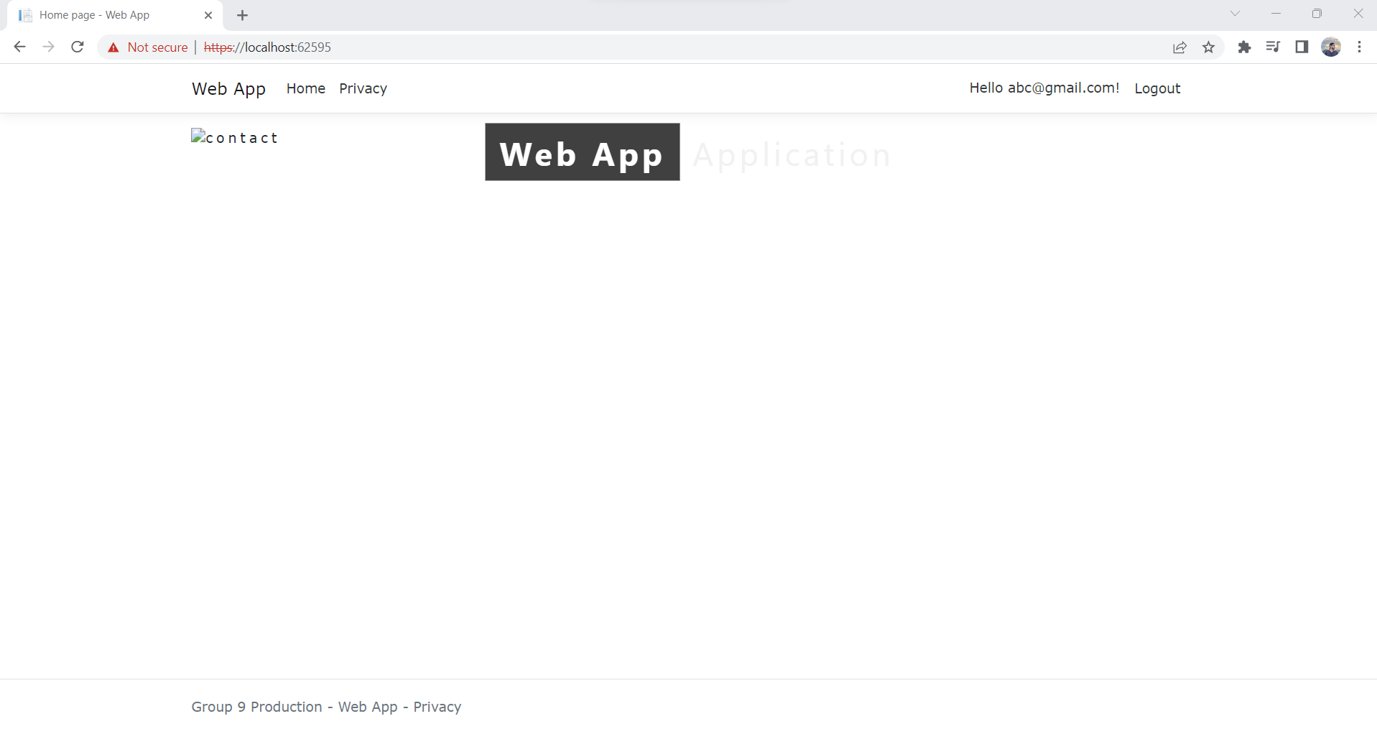
Part 1 Demonstration Welcome Page

Slide 5
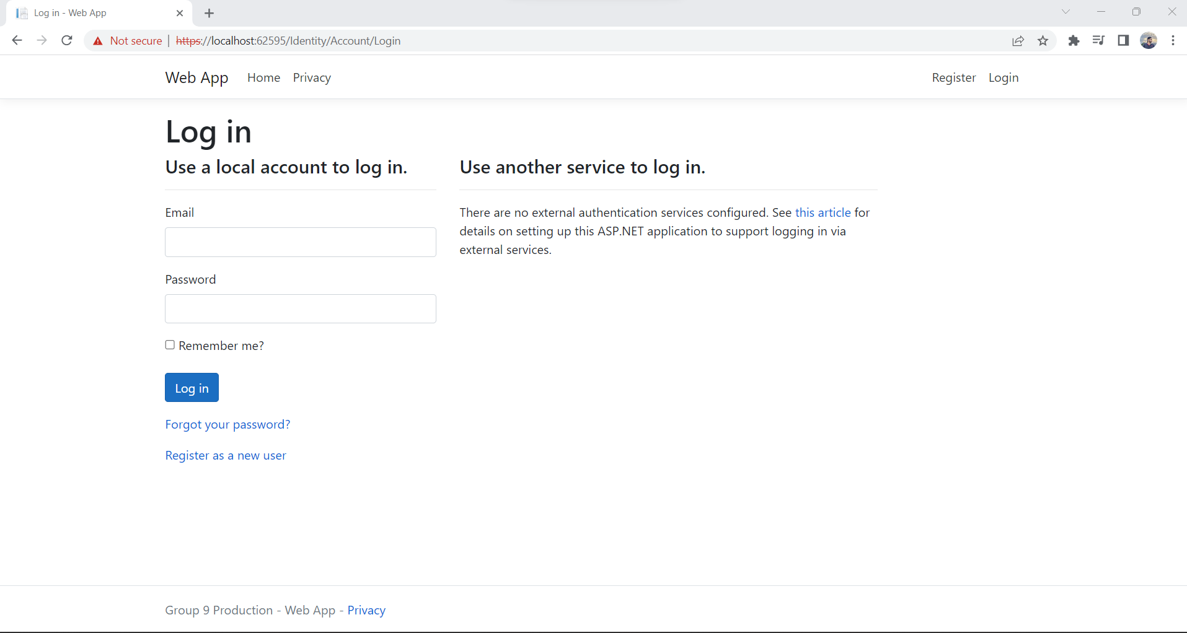
Register Page

Slide 6
Login Page

Slide 7
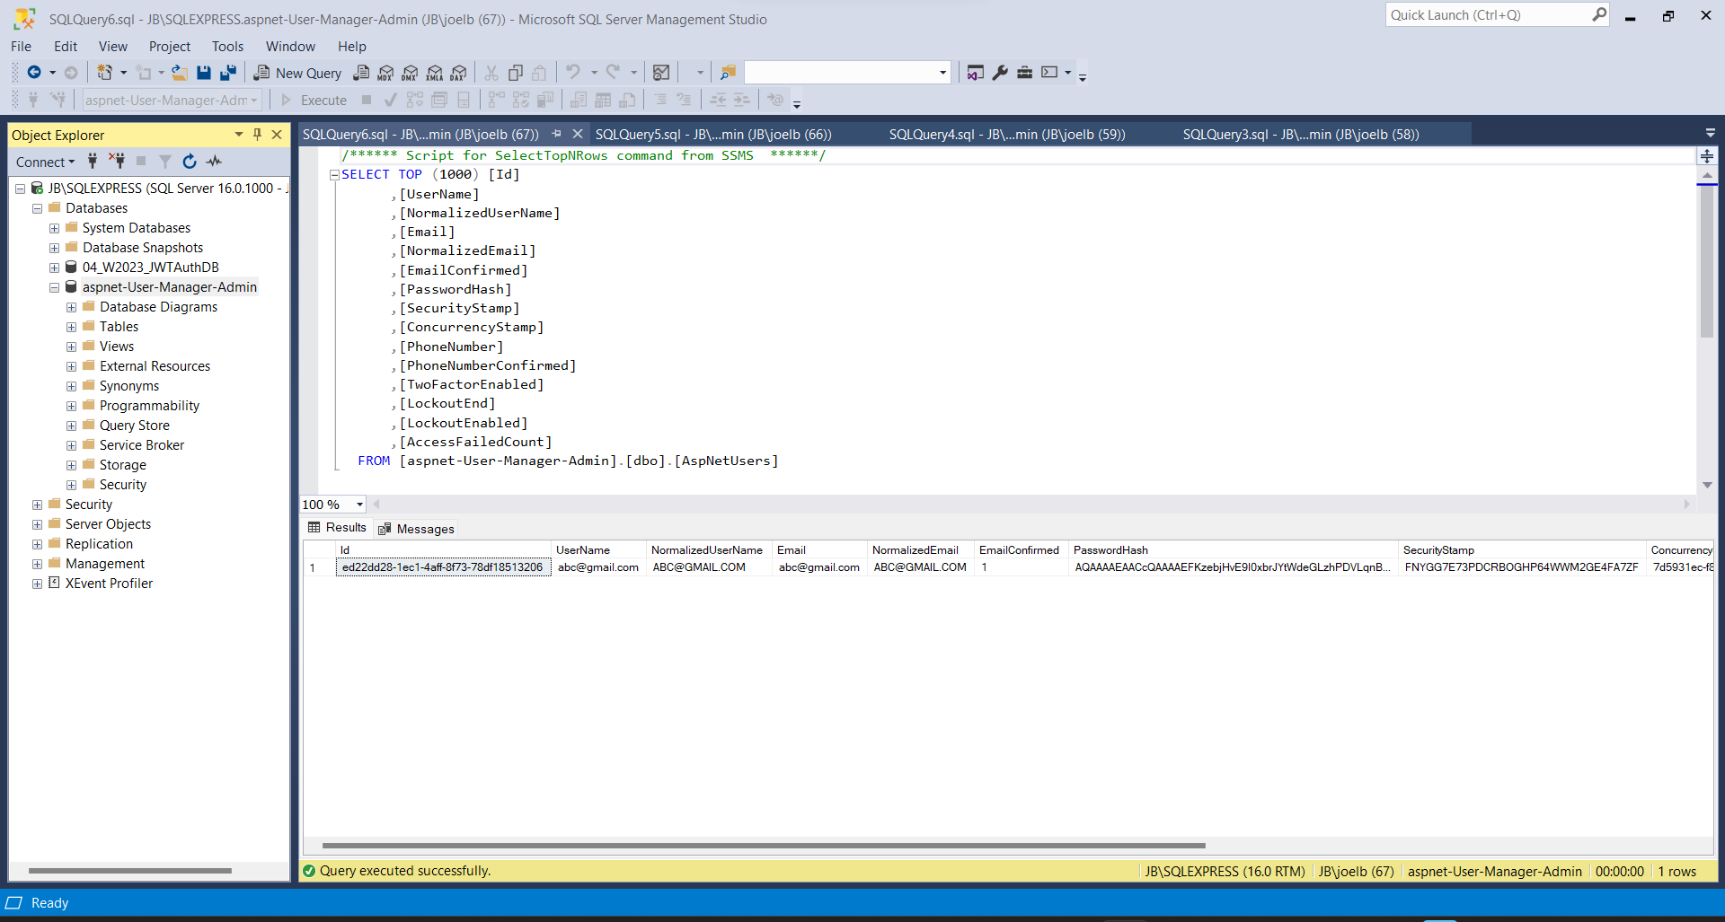
SSMS

Slide 8

Part 2-Security Technologies Recommendations Questions
How can we transfer personal data securely within their network?
What security protocol is best for transferring personal files?
Can we encode and encrypt images?
Our database cannot be moved from the site, and we need to be able to access it externally using a secure API. Can you explain the architecture of a secure API?
Can you recommend a secure framework for coding an API?
What data interchange format should we use while transferring data between locations?
How should we store our data in our many locations?
What are the ethical concerns related to the transmission of personal data?

Slide 9
How can we transfer personal data securely within their network?
There are several ways to transfer personal data securely within a network. Here are some recommendations:
Encryption: Use encryption tools to encrypt the data before transferring it.
Secure File Transfer Protocol (SFTP): Use SFTP to encrypt the data during transfer.
Virtual Private Network (VPN): Use a VPN to create a secure connection between two networks over the internet.
Secure Email: Use email encryption tools like PGP or S/MIME to encrypt the email message and attachments.
Secure Cloud Storage: Use secure cloud storage solutions like Dropbox, Google Drive, or Microsoft OneDrive to transfer personal data between different locations.
Secure Network: Use a secure network that has appropriate access controls in place to limit who can access personal data.

Slide 10

What security protocol is best for transferring personal files?
Transport Layer Security (TLS): TLS is a widely used protocol that provides secure communication over the internet. It uses encryption to protect the data during transfer and also includes mechanisms for authentication and data integrity checks.
Secure File Transfer Protocol (SFTP): SFTP is a secure version of FTP (File Transfer Protocol) that provides encryption and authentication during file transfers. It uses SSH (Secure Shell) to establish a secure connection and can also support access control and data integrity checks.
Pretty Good Privacy (PGP): PGP is a cryptographic protocol that can be used to encrypt and decrypt files, emails, and other data. It uses a combination of symmetric and asymmetric encryption techniques to provide strong security.
Secure Shell (SSH): SSH is a protocol that provides secure communication and data transfer over the internet. It can be used to encrypt file transfers and also includes features for authentication and access control.

Slide 11

Can we encode and encrypt images?
Yes, it is possible to encode and encrypt images
Encoding is the process of converting an image file from one format to another.
Encryption is the process of converting the contents of an image file into a coded or encrypted form to prevent unauthorized access.
Steganography is a method of hiding information within an image or other media file, without visibly altering the file.
Encryption software such as VeraCrypt or BitLocker can be used to create encrypted volumes or containers that can store image files or other sensitive data.
Encoding and encrypting images can affect their quality and may result in larger file sizes.
It's important to ensure that the encryption method used is strong enough to prevent unauthorized access and that the encryption key or password is kept secure.

Slide 12

Our database cannot be moved from the site, and we need to be able to access it externally using a secure API. Can you explain the architecture of a secure API?
An API (Application Programming Interface) is a set of protocols, routines, and tools for building software applications. A secure API is designed to provide secure access to resources such as databases
Authentication: The API should require authentication to ensure that only authorized users can access the data. Ex-API keys
Authorization: The API should ensure that the user has the appropriate permissions to access the data. This can be achieved using SSL/TLS encryption.
Encryption: All data transmitted over the API should be encrypted to protect against interception and unauthorized access.
Input validation: The API should validate all user input to prevent injection attacks and other types of security vulnerabilities.
Rate limiting: The API should include rate limiting to prevent denial-of-service attacks and other forms of abuse.
Logging and monitoring: The API should log all transactions and monitor for suspicious activity to identify potential security breaches.
Firewall and network security: The API should be protected by firewalls and other network security measures to prevent unauthorized access and other types of attacks.

Slide 13
Can you recommend a secure framework for coding an API?
Here are some of the secure frameworks for coding an API that I recommended:
Spring Boot: An open-source Java framework that provides a comprehensive set of features for building secure APIs. It offers a wide range of security features, including authentication, authorization, and encryption, and supports various data storage options.
Django Rest Framework: A powerful Python-based framework that allows developers to quickly build RESTful APIs. It offers several security features, including support for authentication, permissions, and throttling.
Node.js with Express: A JavaScript-based runtime environment and lightweight framework that provides a simple way to build web applications and APIs. It offers several security features, including support for SSL/TLS encryption, authentication, and authorization.
Laravel: A PHP-based framework that offers a powerful set of tools for building secure APIs. It provides support for various security features, including encryption, authentication, and authorization.
Ruby on Rails: A popular framework for building web applications and APIs. It offers several security features, including built-in support for authentication, authorization, and encryption.

Slide 14
What data interchange format should we use while transferring data between locations?
The choice of data interchange format for transferring data between locations depends on several factors, including the nature of the data, the intended use of the data, and the systems involved in the transfer. Here are some of the most popular data interchange formats.
JSON (JavaScript Object Notation): JSON is a lightweight, text-based data interchange format that is easy to read and write. It is widely used in web applications and is supported by most modern programming languages.
XML (Extensible Markup Language): XML is a popular data interchange format that is used in a wide range of applications. It is a flexible and extensible format that allows for structured data and is widely supported.
CSV (Comma-Separated Values): CSV is a simple data interchange format that is commonly used for exchanging tabular data. It is easy to read and write and is supported by most spreadsheet applications

Slide 15
How should we store our data in our many locations?
Storing data in multiple locations is very challenging when ensuring that your data is secure, accessible, and well-organized. Here are some general guidelines we can follow to store our data in many locations.
Determine data storage needs: Define what type of data you need to store, how much data you have, how frequently the data is accessed, and how long you need to keep the data.
Choose storage technologies: Choose the appropriate storage technologies that fit your data storage needs, such as file servers, databases, cloud storage, or a combination of these technologies.
Establish data security policies: Develop data security policies and protocols that apply to all locations where the data is stored, including physical security measures, access controls, encryption, and backups.
Implement data backup and recovery processes: Regularly back up your data and store copies in secure, off-site locations. Develop recovery processes and test them regularly to ensure they work correctly.
Maintain data consistency: Establish data naming conventions, data formats, and data categorization procedures to ensure that your data is consistently named, formatted, and categorized across all locations.
Establish data governance policies: Develop data governance policies to ensure that your data is properly managed, controlled, and used across all locations.
Monitor data usage: Establish mechanisms to monitor data usage across all locations, such as access logs and audit trails, to detect any unauthorized access or activity.

Slide 16

What are the ethical concerns related to the transmission of personal data?
The transmission of personal data raises several ethical concerns, including:
Privacy: Personal data transmission may expose sensitive information about individuals, which could be used for malicious purposes such as identity theft, stalking, or harassment.
Consent: Individuals must give informed consent before their personal data can be transmitted. Ethical concerns arise when consent is not obtained, or when individuals are not fully aware of how their data will be used or shared.
Security: Personal data transmission must be conducted securely to prevent unauthorized access, data breaches, or other forms of cyber-attacks.
Fairness: Ethical concerns arise when personal data is used to discriminate against individuals, such as denying them employment or insurance based on their personal characteristics.
Transparency: Individuals have the right to know how their personal data is being used and shared. Ethical concerns arise when personal data is transmitted without transparency or when individuals are not given access to their data.
Accuracy: Personal data transmitted should be accurate and up-to-date. Ethical concerns arise when inaccurate or outdated data is used to make decisions that affect individuals' lives.
Accountability: Organizations that transmit personal data must be accountable for the data they collect, use, and transmit. Ethical concerns arise when organizations fail to take responsibility for the security and integrity of personal data.

Slide 17
GitHub link
GitHub - Joel991014/FinalProject_BDAT1001

Slide 18

THANK YOU

